Slide 1
BOP-Day 5

Slide 2
Day | Topics | Subtopics
1 | Concept | Meaning
 |  | Advantages
 |  | Eligibility Rules and its need
 |  | BOP Vs CPP
2 | Coverages | Commercial Property Insurance (BOP Vs CPP)
 |  | General Liability Insurance
 |  | Business Interruption Insurance
 |  | Business Interruption Insurance
3 | Exclusions Endorsements Additional Coverages | What’s Not Covered?
 |  | Extra Expenses
 |  | Inland Marine
 |  | Equipment Breakdown
 |  | Spoilage
 |  | Employee Theft
 |  | Etc.
4 | BOP Rating & Premium Guidelines | Rating factors
 |  | Premium Guidelines
 |  | What Does a BOP Cost
 |  | Average Cost of a BOP
5 | BOP Policy issuance | BOP Policy Forms
 |  | Input Forms Output Forms
 |  | Policy Issuance Flow
 |  | Case study & Discussion- A snapshot at a Restaurant looking for insurance- shared as BOP Made Easy PDF
 |  | Sample Policy
 |  | Declaration Page- A snap shot
 |  | Declaration Page- A snap shot
6 | Claims Handling | Valuation Methods, Property Damage Assessment and
 |  | Recovery for Business Owners
 |  | Filing a claim
 |  | Documents Required for Claim Process
 |  | Claims Flow Process

Slide 3
BOP Policy issuance
 | Input Forms Output Forms
 | Specific Forms- Conditional Forms
 | Policy Issuance Flow
 | Case study & Discussion- A snapshot at a Restaurant looking for insurance- shared as BOP Made Easy PDF
 | Sample Policy
 | Declaration Page- A snap shot
Notes:
What are forms in insurance?
Policy form - The definitions, insuring agreement, exclusions, and conditions are typically combined into a single integrated document called a policy form. Some insurers call it a coverage form or coverage part.
What are ISO forms in insurance?
Causes of Loss Forms (ISO), commercial property insurance forms that establish and define the causes of loss (or perils) for which coverage is provided.
Where can I find ISO forms?
www.documents.dgs.ca.gov - /iso/Forms/

Slide 4
BOP Input – Application Form
Documents required for obtaining Insurance
BOP Statutory Forms
BOP Conditional / Coverage specific Forms
Illustration – Conditional / Optional Forms
BOP - Various Forms Packages
Sample Forms
Policy process flow
Notes:
Insurance is a Business, which works as any other business on the concept of Input-Process-Output.

Slide 5
BOP – Application Form (Input Criteria)
BOP – The application form for any Business Owners Policy will be broadly classified in these sections as per “ISO” standard
Policy Effective and Expiry Date
Company Name and details
Agency details
Applicant Information
Nature of Business
Premises details
Property details
Liability / limit options
Prior Insurance and Loss Information
Optional / Additional Coverage information)
General Information
Mechanical Equipment details
Specialty Programs
Crime details
Additional Interest
Remarks
Applicant and Agent signature with date
Notes:
The rating and premium development method Insurance Services Office (ISO) uses with its Businessowners Program is fairly straightforward but the individual component parts require some explanation.
The Guidelines are as yardstick, within which Insures customise or modify their products.

Slide 6
Documents required for obtaining Insurance
Which documents do I need to submit while buying Insurance for BOP?
Proposal Form/Quote (if applicable)
Proof that property is owned (if it is shown as owned)
Previous Insurance Policy (if applicable)
Complete Application form as shown previously
Business Tax returns
Company’s and Vendors’ Licenses/Certificates for business operations
Corporate or Partnership Documents
Lease Documents
Company loss runs for current policy period plus last three "or" signed and dated no loss letter on company's letterhead
Notes:
What are the 5 parts of an insurance policy?
Every insurance policy has five parts: declarations, insuring agreements, definitions, exclusions and conditions. Many policies contain a sixth part: endorsements.

Slide 7
BOP – Statutory Forms
Statutory forms are the forms which are mandatory to be issued / printed while a policy is issued by the insurer.
These forms are state specific and will differ in content as well as other Limit related rules specific to different states.
List of all mandatory forms for “A” carrier as an illustration is as given below –
PUNITIVE DAMAGES COVERAGE PUNITIVE DAMAGES COVERAGE ILLINOIS
VIRGINIA IMPORTANT NOTICE - NO FLOOD COVERAGE
AMENDMENT OF MOBILE EQUIPMENT DEFINITION
AMENDMENT OF OCCURRENCE DEFINITION FOR SUBCONTRACTED WORK
AMENDMENT OF POLICY - TWO OR MORE COVERAGE PARTS
CAP ON LOSSES FROM CERTIFIED ACTS OF TERRORISM
COMMERCIAL GENERAL LIABILITY COVERAGE FORM
COMMON POLICY CONDITIONS
DISCLOSURE PURSUANT TO TERRORISM RISK INSURANCE ACT
EMPLOYMENT-RELATED PRACTICES EXCLUSION
EXCLUSION - LEAD LIABILITY
FUNGI OR BACTERIA EXCLUSION
ILLINOIS CHANGES - CANCELLATION AND NONRENEWAL
IMPORTANT NOTICE TO POLICYHOLDERS - TERRORISM COVERAGE - PROPERTY

Slide 8
BOP – Coverage specific / Optional Forms
These forms are part of the policy package only if any optional / additional coverage is selected by the
insured on a policy over and above the mandatory covers.
These forms also will be state specific as the U/W rules and guidelines will be different for different
States. Conditional forms will be triggered based on few conditions mentioned on the system, i.e. if the
following criteria is met on a policy, only then certain form will be printed for that policy
List of few optional forms are as given below –
INLAND MARINE GENERAL CONDITIONS
INLAND MARINE GENERAL CONDITIONS – ILLINOIS
RENTED/LEASED MOBILE EQUIPMENT - BLANKET COVERAGE
LIQUOR LIABILITY COVERAGE FORM
COVERAGE FOR INJURY TO LEASED WORKERS
EMPLOYEE BENEFITS LIABILITY COVERAGE
ADDITIONAL INSURED - CONCESSIONAIRES TRADING UNDER YOUR NAME
PROFESSIONAL LIABILITY EXCLUSION - WEB-SITE DESIGNERS
WAIVER OF IMMUNITY ENDORSEMENT
NEW YORK -- WINDSTORM PROTECTIVE DEVICES
INSTALLATION COVERAGE - COMPREHENSIVE PERILS
ILLINOIS MINE SUBSIDENCE - COMMERCIAL BUILDING

Slide 9
Illustration – Conditional Forms
Conditional forms will be triggered based on peculiar conditions getting met
Illustration 1–
INLAND MARINE GENERAL CONDITIONS will be generated only if following condition is met
Condition - If [Bailees Customers Coverage Indicator] or [Coin and Stamp Dealers Coverage Indicator] or [Physicians & Dentists Equipment Coverage Indicator] or [Musical Instruments Coverage Indicator] or [Fine Arts Coverage Indicator] or [Appliance Sales & Service Coverage Indicator] or [Installation Coverage Indicator] or [Animal Floater Coverage Indicator] or [Tools Coverage Indicator] or [Contractors Equipment Coverage Indicator] or [Motor Truck Cargo Coverage Indicator] or [Photographic Equipment Coverage Indicator] or [Broad Form Specified Property Coverage Indicator] is selected
Illustration 2 –
RENTED/LEASED MOBILE EQUIPMENT - BLANKET COVERAGE will be generated only if following
condition is met
Condition - If [Contractors Equipment Coverage Indicator] is selected and [Contractors Equipment
Peril Type] = Comprehensive Perils

Slide 10
BOP – Various Forms Packages
All forms which are printed by a company will be clubbed under various packages / batches.
This is required to allocate similar forms under the same package.
These differentiation of packages will be company specific, as per company’s filter/ selection criteria and hence they will differ from carrier to carrier.
Broadly sequencing of forms will be like –
- Policy Jacket
- Property Coverage Part
-Amendatory Property Endorsement
- Property Coverage Endorsement
- Property Exclusion Endorsement
- Amendatory Important Notice
- Amendatory
- Inland Marine General Terms Endorsement
- Inland Marine Endorsements
- General Liability Coverage Part
- Amendatory General Liability Endorsements
- General Liability Coverage Endorsements
- General Liability Exclusion Endorsements

Slide 11
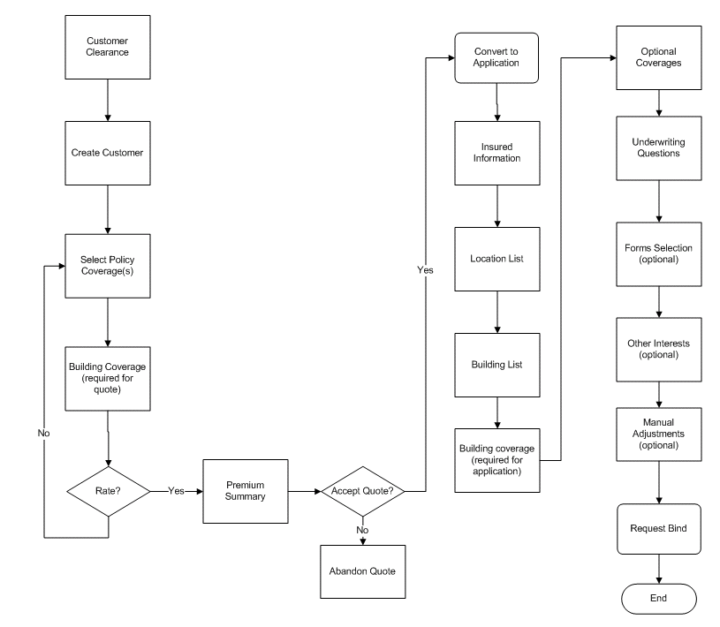
Policy issuance Process

Slide 12
Sample Forms
BOP – Application Form (Input)
BOP – Conditional Form (Output)

